Slide 1
Lightning Talks
Local Planning Grant Recipients

Slide 3
Empowering families with STEM and Digital Literacy

Slide 4
512 Latinas/os
87%
81%
age 18 to 50 years old.
annual incomes less than $ 50,000.
73%
61%
are Renters or live with friend or family rent free.
speak only Spanish.
40%
2%
lives in Salt Lake City.
have disability.
Notes:
Redondear bordes.

Slide 5
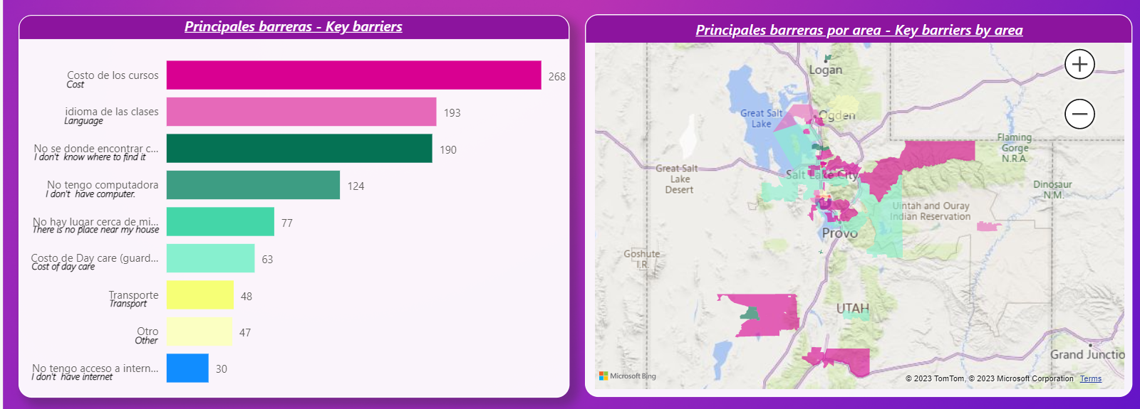
Key barriers
Notes:
Redondear bordes.

Slide 6
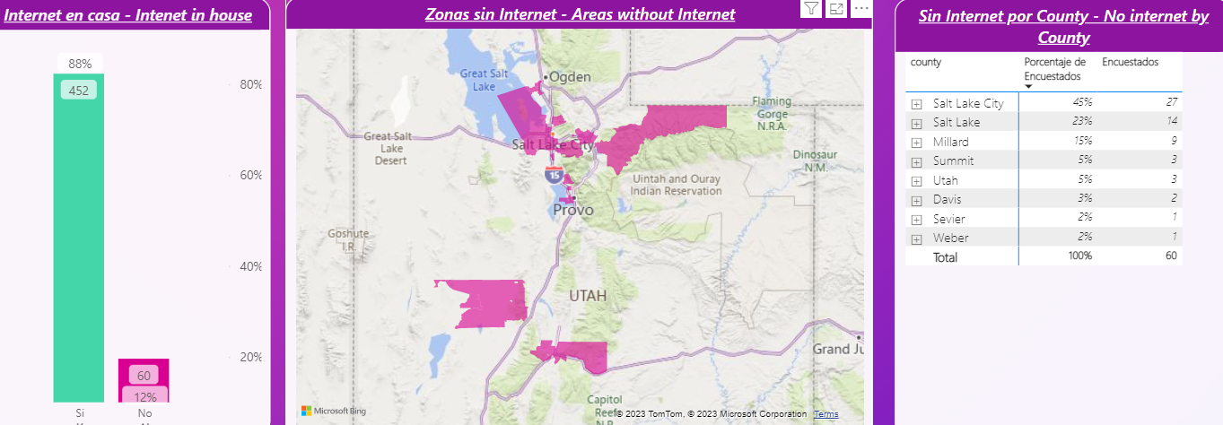
Internet access
Notes:
Redondear bordes.

Slide 7
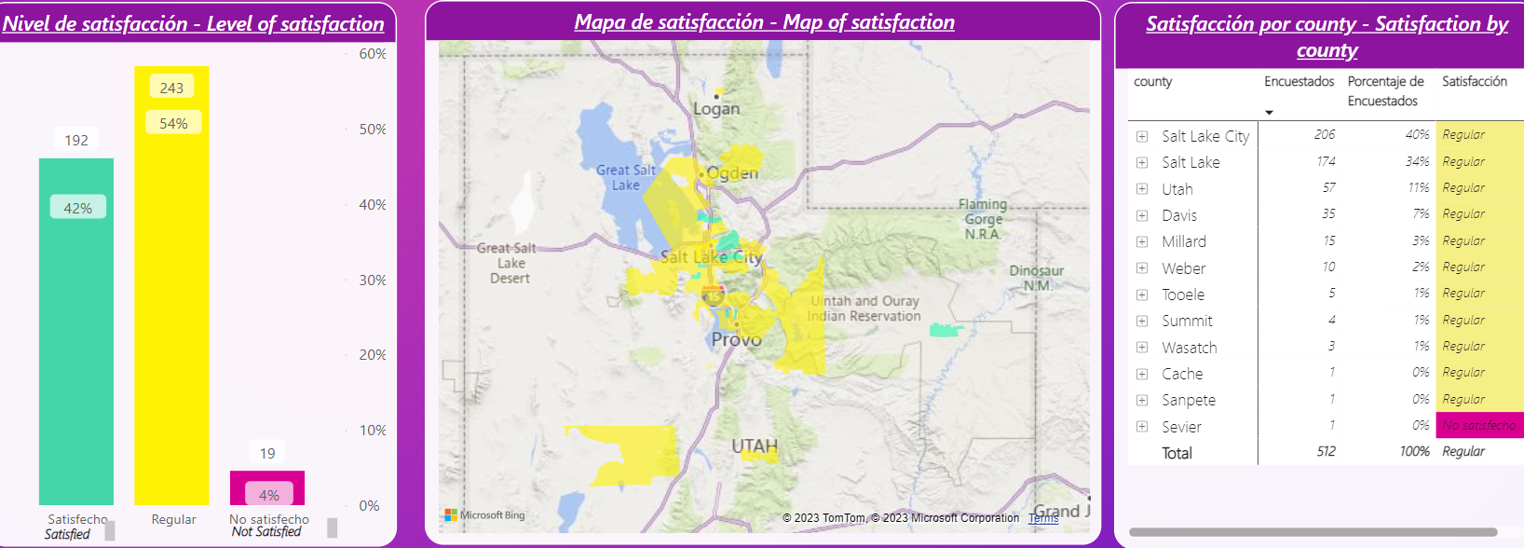
Internet :Satisfaction
Notes:
Redondear bordes.

Slide 8
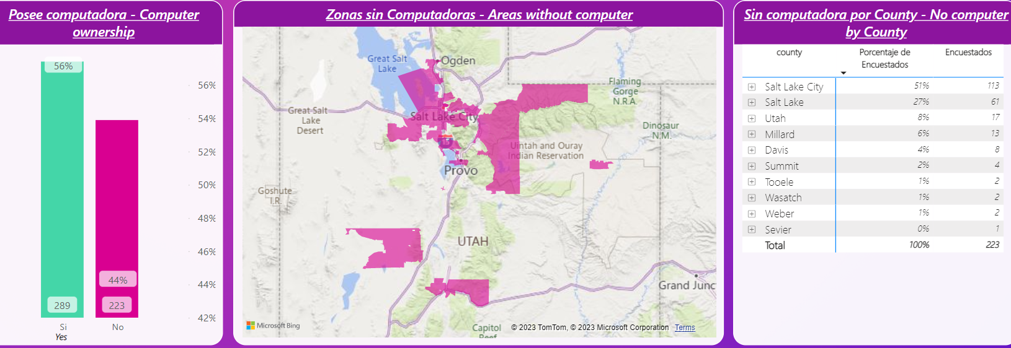
Access to computers
Notes:
Redondear bordes.

Slide 9
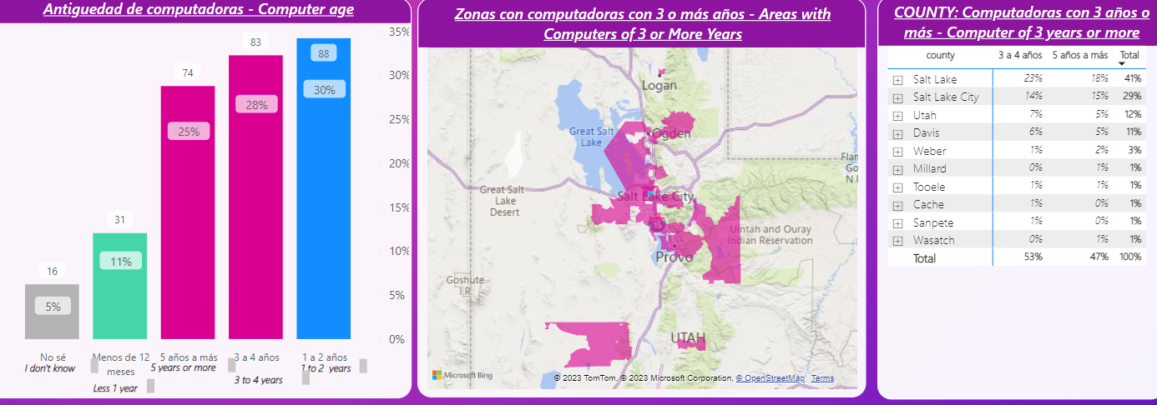
Computer Age
Notes:
Redondear bordes.

Slide 10
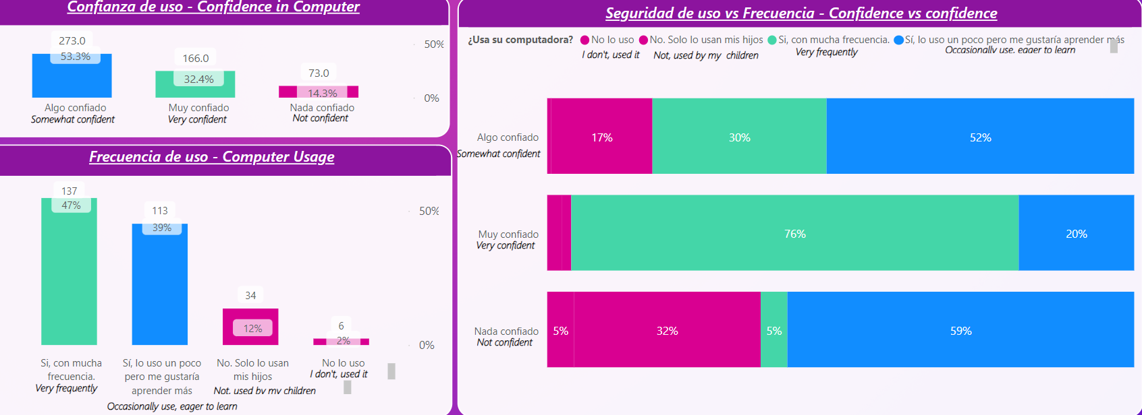
Computer confidence
& usage frequency
Notes:
Redondear bordes.

Slide 11
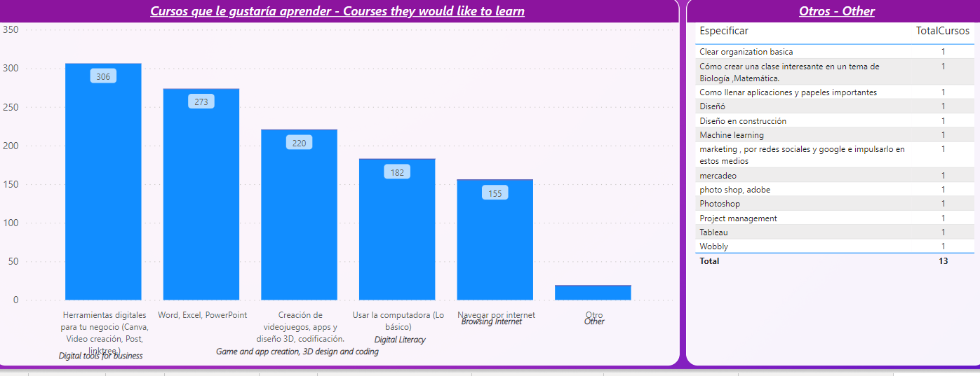
Courses
Notes:
Redondear bordes.

Slide 13
PLAN GOALS
Utah County residents, including seniors and Hispanic or Latino neighbors, have quality, appropriate technology devices in their homes.
Utah County residents have Digital Skills Necessary to Utilize Devices to access affordable, quality broadband.

Slide 14
PROCESS
Successes
Tremendous support from companies, organizations, and cities that were interested in supporting us through this grant process.
Overall has been a smooth process
Challenges
Last minute disaster

Slide 15
NEXT STEPS
Collaborating with our partners to finalize our plan
THANK YOU

Slide 18
Digital Equity Research
Main Street, Salt Lake City, Utah
Notes:
Size and Position Notes:
Background Image
Size: Height 6.62”, Width 12.64” Position: Horizontal 0.35”, Vertical 0.34”
Main Title
Box Size: Height 2.15”, Width 10.03”
Position: Horizontal 1.0”, Vertical 2.12”
(Bottom of text should be aligned with the bottom of the dot logo)
Subtitle
Box Size: Height 0.48”, Width 10.03”
Position: Horizontal 1.0”, Vertical 4.3”
Logo:
Size: Height 0.78”, Width 0.59” Position: Horizontal 11.79”, Vertical 3.26”
(When selecting the background image and the logo, Arrange 🡪 Align 🡪 Middle. This aligns the logo vertically to the background image.)
Caption:
Box Size: Height 0.86”, Width 0.94” Position: Horizontal 11.79”, Vertical 5.88”

Slide 19
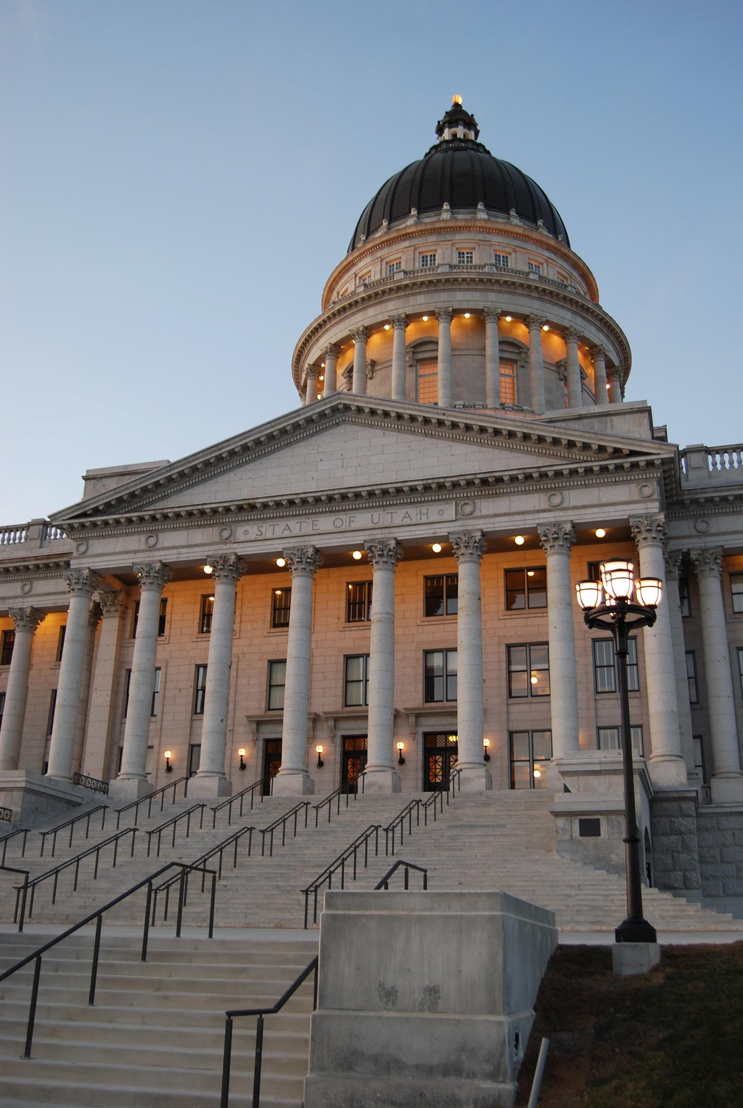
Progression of the Presentation
Type of household internet used
Internet affordability
Digital literacy
Availability of devices and technical support
Socio-economics
Utah’s state capitol building
Notes:
Size and Position Notes:
Slide Title
Box Size: Height 0.66”, Width 7.25”
Position: Horizontal 0.55”, Vertical 0.45”
Text Box
Box Size: Height 5.2”, Width 6.57”
Position: Horizontal 0.55”, Vertical 1.35”
(Text within the box should be middle aligned)
Image Box
Box Size: Height 7.5”, Width 5.02”
Position: Horizontal 8.31”, Vertical 0.0”
Image Caption
Box Size: Height 0.59”, Width 0.83”
Position: Horizontal 12.27”, Vertical 6.85”
Logo
Fixed from master slide

Slide 20
Type of Household Internet
Notes:
Size and Position Notes:
Background Image
Size: Height 6.62”, Width 12.64” Position: Horizontal 0.35”, Vertical 0.34”
Section Header Title
Box Size: Height 2.15”, Width 10.03”
Position: Horizontal 1.0”, Vertical 2.12”
(Bottom of text should be aligned with the bottom of the dot logo)
Subtitle
Box Size: Height 0.48”, Width 10.03”
Position: Horizontal 1.0”, Vertical 4.3”
Logo:
Size: Height 0.78”, Width 0.59” Position: Horizontal 11.79”, Vertical 3.26”
(When selecting the background image and the logo, Arrange 🡪 Align 🡪 Middle. This aligns the logo vertically to the background image.)

Slide 21
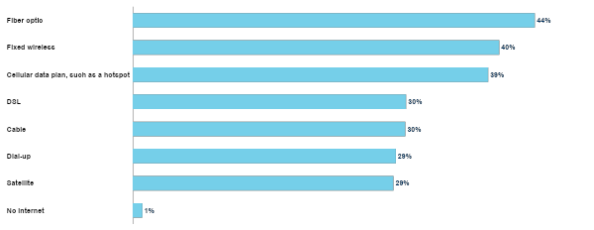
Type of Household Internet
Q2: Do you or any member of your household subscribe to internet service in your home? What technology do you use? (Select all that apply) (n = 1,150)

Slide 22
Internet Affordability
Notes:
Size and Position Notes:
Background Image
Size: Height 6.62”, Width 12.64” Position: Horizontal 0.35”, Vertical 0.34”
Section Header Title
Box Size: Height 2.15”, Width 10.03”
Position: Horizontal 1.0”, Vertical 2.12”
(Bottom of text should be aligned with the bottom of the dot logo)
Subtitle
Box Size: Height 0.48”, Width 10.03”
Position: Horizontal 1.0”, Vertical 4.3”
Logo:
Size: Height 0.78”, Width 0.59” Position: Horizontal 11.79”, Vertical 3.26”
(When selecting the background image and the logo, Arrange 🡪 Align 🡪 Middle. This aligns the logo vertically to the background image.)

Slide 23
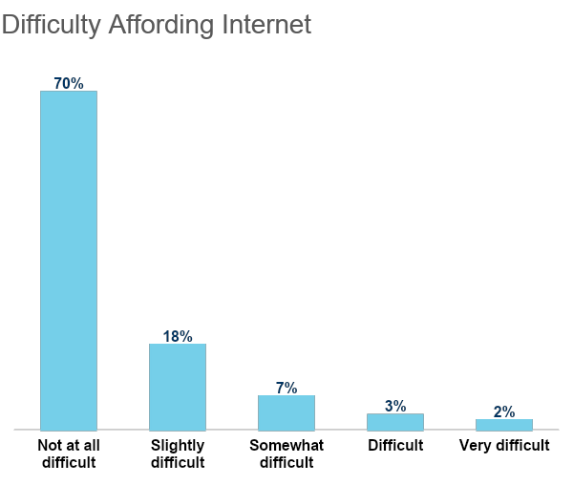
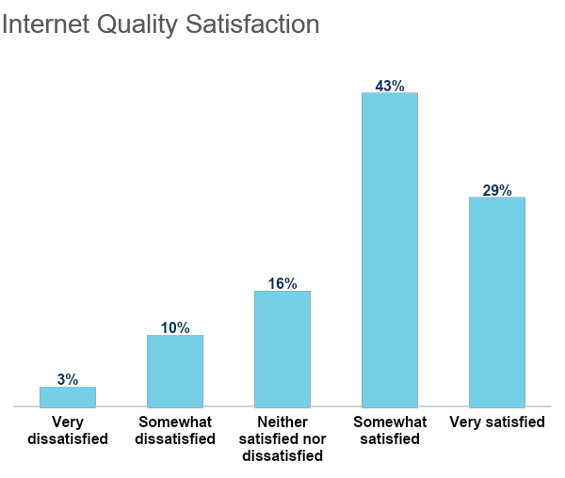
Type of Household Internet
95%
Pay for internet
Q3: Do you pay for the internet? (n = 1,139) | Q5: Is it difficult for your household to afford internet service costs? (n = 1,086)
Q6: How satisfied are you with the quality of your home internet connection for doing the activities that are important to you? (n = 1,139)

Slide 24
Digital Literacy

Slide 25
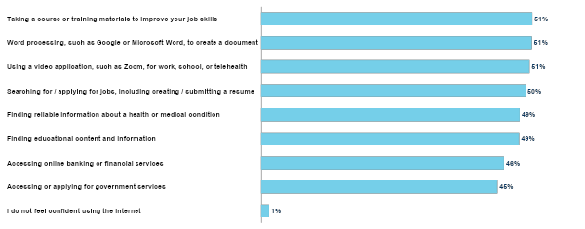
Digital Literacy
Q7: What types of activity do you feel confident using the internet for? (select all that apply)

Slide 26
Availability of devices and technical support
Notes:
Size and Position Notes:
Background Image
Size: Height 6.62”, Width 12.64” Position: Horizontal 0.35”, Vertical 0.34”
Section Header Title
Box Size: Height 2.15”, Width 10.03”
Position: Horizontal 1.0”, Vertical 2.12”
(Bottom of text should be aligned with the bottom of the dot logo)
Subtitle
Box Size: Height 0.48”, Width 10.03”
Position: Horizontal 1.0”, Vertical 4.3”
Logo:
Size: Height 0.78”, Width 0.59” Position: Horizontal 11.79”, Vertical 3.26”
(When selecting the background image and the logo, Arrange 🡪 Align 🡪 Middle. This aligns the logo vertically to the background image.)

Slide 27
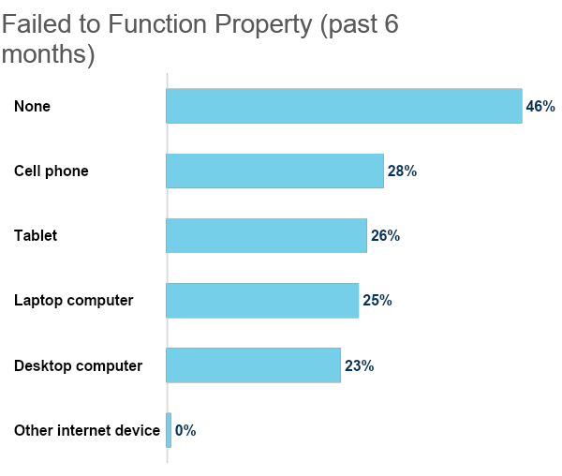
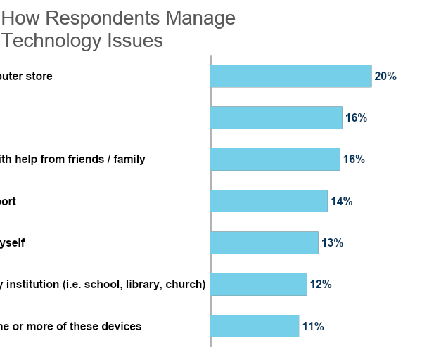
Device Availability and Technical Support
92%
Have enough computer devices
Q8: Does your household have enough computer devices (laptop, desktop, tablet computer) available to meet the needs of those living in this home? (n = 1,139)
Q9: In the past 6 months, which of the following technology devices have failed to function properly for you? (Select all that apply) (n = 1,139)
Q10: How did you deal with the problem you encountered? (Select all that apply) (n = 1,139)

Slide 28
Socio-economics
Notes:
Size and Position Notes:
Background Image
Size: Height 6.62”, Width 12.64” Position: Horizontal 0.35”, Vertical 0.34”
Section Header Title
Box Size: Height 2.15”, Width 10.03”
Position: Horizontal 1.0”, Vertical 2.12”
(Bottom of text should be aligned with the bottom of the dot logo)
Subtitle
Box Size: Height 0.48”, Width 10.03”
Position: Horizontal 1.0”, Vertical 4.3”
Logo:
Size: Height 0.78”, Width 0.59” Position: Horizontal 11.79”, Vertical 3.26”
(When selecting the background image and the logo, Arrange 🡪 Align 🡪 Middle. This aligns the logo vertically to the background image.)

Slide 29
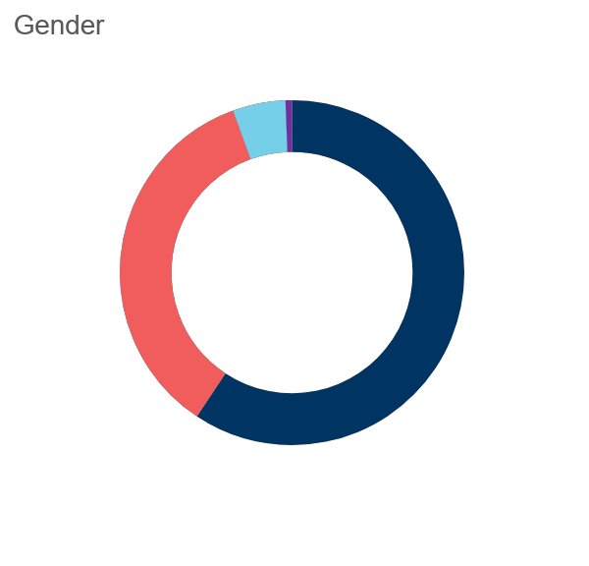
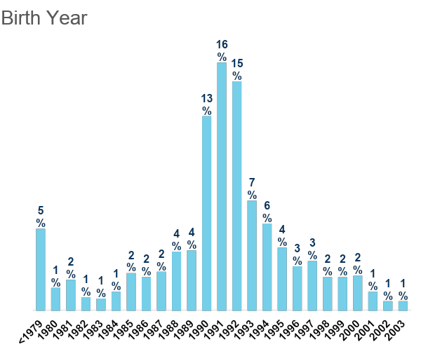
Socio-economics
3
Adults currently living in household
Q11: What is your gender identity? (n = 1,150)
Q12: What year were you born? (n = 1,150)
Q13: How many adults, age 18 and over, currently live in your household, including yourself? (n = 1,150)

Slide 30
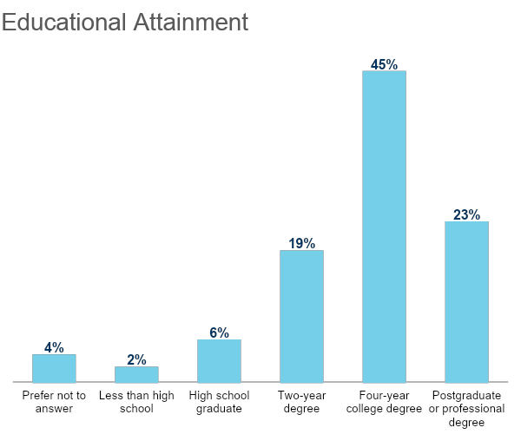
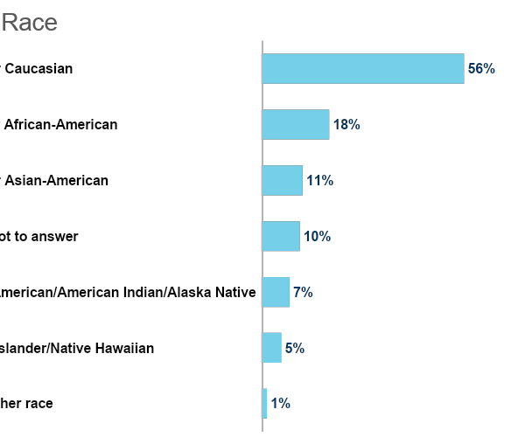
Socio-economics
27%
Hispanic, Latino, or of Spanish origin
Q14: What is the highest level of school you have completed? (n = 1,150)
Q15: Are you of Hispanic, Latino, or Spanish origin, such as Mexican, Puerto Rican, or Cuban? (n = 1,150)
Q16: Which of the following best describes your race? (Select all that apply) (n = 1,150)

Slide 31
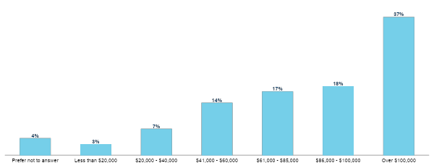
Income
Q17: What is your total annual household income, before taxes? (n = 1,150)

Slide 32
Conclusions
Notes:
Size and Position Notes:
Background Image
Size: Height 6.62”, Width 12.64” Position: Horizontal 0.35”, Vertical 0.34”
Section Header Title
Box Size: Height 2.15”, Width 10.03”
Position: Horizontal 1.0”, Vertical 2.12”
(Bottom of text should be aligned with the bottom of the dot logo)
Subtitle
Box Size: Height 0.48”, Width 10.03”
Position: Horizontal 1.0”, Vertical 4.3”
Logo:
Size: Height 0.78”, Width 0.59” Position: Horizontal 11.79”, Vertical 3.26”
(When selecting the background image and the logo, Arrange 🡪 Align 🡪 Middle. This aligns the logo vertically to the background image.)

Slide 33
Conclusions
Most household internet is fiber optic, fixed wireless, or a cellular hotspot.
95% of respondents pay for the internet and 30% consider it at least “slightly difficult” to make those payments.
Roughly 50% of respondents are not confident doing typical tasks on the internet.
92% of respondents have enough devices and about half have had some sort of technical issue in the past six months with one of those devices.
Visiting a computer store, finding help online, and asking friends and family are the primary ways respondents find help with a technical issue.
Utah’s state capitol building
Notes:
Size and Position Notes:
Slide Title
Box Size: Height 0.66”, Width 7.25”
Position: Horizontal 0.55”, Vertical 0.45”
Text Box
Box Size: Height 5.2”, Width 6.57”
Position: Horizontal 0.55”, Vertical 1.35”
(Text within the box should be middle aligned)
Image Box
Box Size: Height 7.5”, Width 5.02”
Position: Horizontal 8.31”, Vertical 0.0”
Image Caption
Box Size: Height 0.59”, Width 0.83”
Position: Horizontal 12.27”, Vertical 6.85”
Logo
Fixed from master slide

Slide 34
Thank You.
Notes:
Size and Position Notes:
Background Image
Size: Height 6.62”, Width 12.64” Position: Horizontal 0.35”, Vertical 0.34”
Section Header Title
Box Size: Height 2.15”, Width 10.03”
Position: Horizontal 1.0”, Vertical 2.12”
(Bottom of text should be aligned with the bottom of the dot logo)
Subtitle
Box Size: Height 0.48”, Width 10.03”
Position: Horizontal 1.0”, Vertical 4.3”
Logo:
Size: Height 0.78”, Width 0.59” Position: Horizontal 11.79”, Vertical 3.26”
(When selecting the background image and the logo, Arrange 🡪 Align 🡪 Middle. This aligns the logo vertically to the background image.)

Slide 36
Intelligent Aging Utah Broadband Confluence June 07, 2023
Rob Ence, MBA
Executive Director
Utah Commission on Aging

Slide 37
Public Policy
Research
& Academia
Communications
Website – Podcast – Social Media
Empowered Public
Communications
Website – Podcast – Social Media
Empowered Public
Community
Resources

Slide 38
Independence
Social Isolation
Food Insecurity
Abuse & Fraud
Emergency Preparedness
Ageism
Fitness
Falls Prevention
Health & Wellness
Long-Term Care
Caregiving
Mobility & Transportation
Financial Adequacy
Housing /Aging In Place
Mental Acuity
End of Life

Slide 39
Stages of Ability
Independence
Interdependence
Dependency
Crisis management
End of life

Slide 40
Who Gets to Choose?
Values
Outcomes
Costs & timing
Relationship impact
Systems will act
Notes:
Shared decision making = Patient / Provider
Caregiver’s understanding of patient’s wishes, not willingness and ability
Over-confident execution may result in unwanted outcomes
Engage in ongoing meaningful conversations about ACP
Ask the right questions
Decide what matters most
Medical decision maker
Kind of medical treatment wanted
Comfort level desired
Sharing your medical wishes

Slide 41
Gaps and Barriers
Post Pandemic Paradigm – Change
Finite Resources
Affordable Access
Device Acquisition
Advocate Mentoring

Slide 42
Essential Literacy
Technology
Health & Wellness
Financial
Legal

Slide 43
Incremental Progress
In Place
Virtual Resource Center
Event Management
Coming
Call Center Triage
Digital Navigator Volunteers

Slide 44
UCOA Virtual Ecosystem
UCOA Navigation Hotline
888-985-6866
(Fall 2023)
Innovative Practices & Initiatives
Virtual Resource Center
UCOA Virtual Resource Center
www.utahaging.org
Event & Volunteer Management
Utah Master Plan on Aging
Inform Policy & Support Research
Public Access & Awareness
Convene / Support Partners
UCOA Facebook
https://www.facebook.com/utahaging/
UCOA YouTube Channel
https://www.youtube.com/channel/UCfSJREf73GpswhCGhFeHZCg/videos

Slide 46
Shivwits Band of Paiutes
Local Digital Access Plan Development Process

Slide 47
Shivwits Band of Paiutes - Background
Federally recognized sovereign Indian Tribe consisting of 311 members living on and off the 28,480-acre Shivwits Reservation located in Washington County
Approximately 27% of Band members living in poverty
Diverse age distribution (26% age 0-17; 57% age 18-54; 17% age 55+)
Shivwits Band Corporation (SBC), wholly owned by the Shivwits Band, has five operating entities

Slide 48
Digital and Broadband Needs
Current internet access via unreliable wireless connection, especially problematic when multiple devices in use
Band members and SBC enterprises need better, more affordable broadband options
Band members rely mostly on smartphones for digital access and would benefit from access to other digital devices
Band members would benefit from digital literacy instructional opportunities

Slide 49
Digital Planning Process (to date)
Kickoff meeting with Band officials, community collaborators, and Horrocks (consultants) on April 13th
Survey developed and subsequently sent to Band members on May 1st along with grant informational materials
Band representatives went door to door on Reservation encouraging members to take survey and speed test
Visioning meeting between Band officials and Horrocks on May 5th
Community Collaborator survey developed and sent to community representatives who attended April 13th Kickoff meeting
Rough draft of digital access plan delivered to Utah Broadband Center on June 1st.

Slide 50
How Challenges were Addressed
Problem: Encouraging Band member participation in process Solution: Posted informational flyers in locations frequented by Band members (Band Building, Band gymnasium, and Band convenience store), had Band representatives go door to door on Reservation encouraging participation, and emailed survey and information to Band members for whom email address information was available.
Problem: Educating Band members regarding need for digital literacy Solution: This is ongoing. The Band is working toward developing a computer classroom in Band Building to use for digital access and instruction.

Slide 51
Planning Process Successes
Heightened awareness among Band members regarding importance of digital connectivity
Firmed up connections with community partners (Washington County, Washington County School District, Washington County Library System, and Utah Tech University) that will prove beneficial to Band’s digital equity efforts

Slide 52
Next Steps
Continue gathering survey/speed test data to inform plan updates/revisions
Foster ongoing relationships with community collaborators
Devote portion of Shivwits.org website to digital literacy education and resources
Mount campaign to promote Affordable Connectivity Plan (ACP)
Pursue additional funding opportunities to further Band’s digital equity efforts

Slide 54
Davis School District + Partners
Canyon Heights
Adult Learning Center

Slide 55
Biggest Problem in Davis County - Accessibility
Affordable high-speed internet connection.
High-speed capable computing device(s) in every home.
Support/help in finding affordable plans and devices.
Digital skill development and digital fluency.
Internet safety and awareness.
WE’RE BETTER WHEN WE WORK TOGETHER!!!

Slide 58
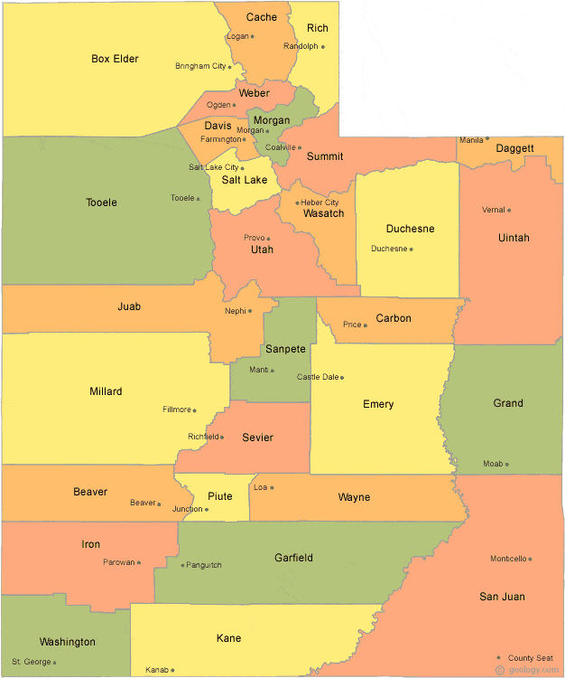

Slide 59
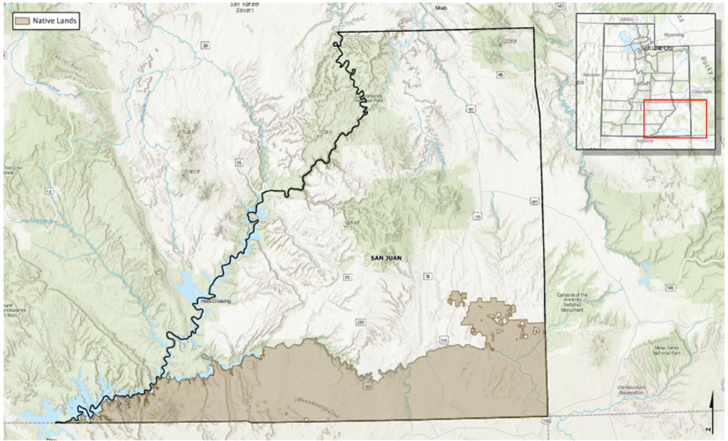

Slide 61
Northern Utah
Box Elder, Cache, Rich Counties
Approximately 200,000 people
Underserved populations
Remote Rural
Low Income
Limited English Proficiency

Slide 62
Bear River Regional Broadband Access Plan
Plan – gap analysis, preliminary investment estimates
Challenges
Separating fact from fiction
Building political will
Timing
Successes
Closing the information gap
New partnerships

Slide 63
Bear River Regional Broadband Access Plan
Next steps
Identify appropriate funding sources for public investment
Prioritize public investment
Grow provider involvement
Recommendations
Incentivize “Dig-Once” policies for small jurisdictions
Notifications are helpful
Conduit costs money

Slide 65
Utah Education & TeleHealth Network

Slide 66
Notes:
Stewart Water Company - Fredonia, AZ - 1885, 27 yrs before AZ became a state… 1912

Slide 67
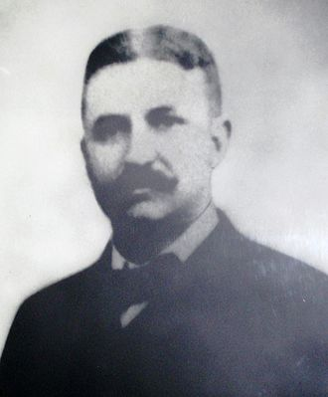
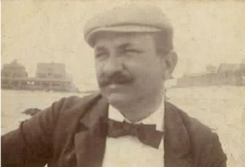
John L. Leal
John Laing Leal (May 5, 1858 – March 13, 1914) was an American physician. a health officer for the nearby City of Patterson, and sanitary advisor to the Jersey City Water Supply Company. He had witnessed and experienced personal loss from waterborne disease.
In 1908, the first disinfection system for drinking water in the U.S. was installed on the water supply for the city by John L. Leal. He was one of the principal expert witnesses at two trials which examined the quality of the water supply in Jersey City, New Jersey, and which evaluated the safety of chlorine in "pure and wholesome" drinking water…
Notes:
https://waterandhealth.org/safe-drinking-water/celebrating-dr-john-l-leal-and-110-years-of-u-s-drinking-water-chlorination/

Slide 68
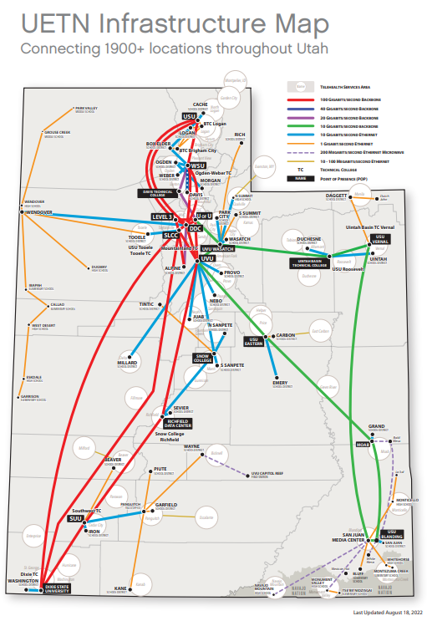

Slide 69
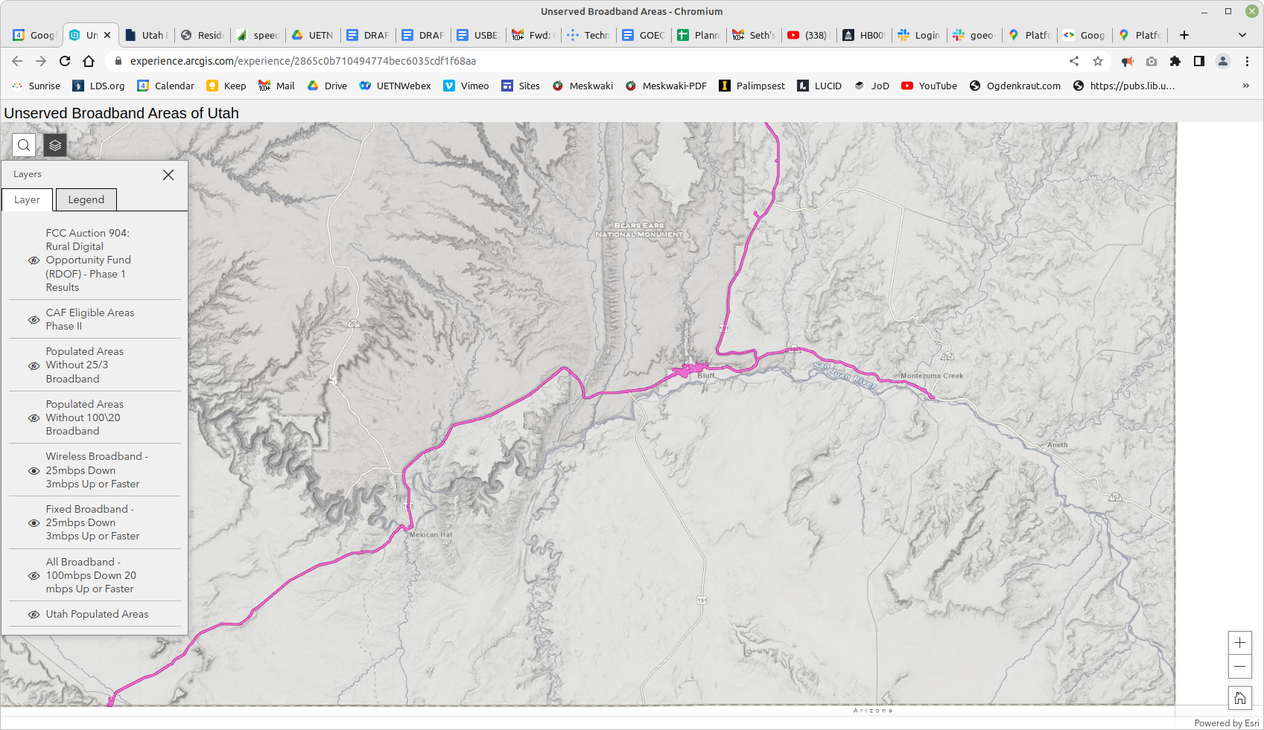

Slide 70
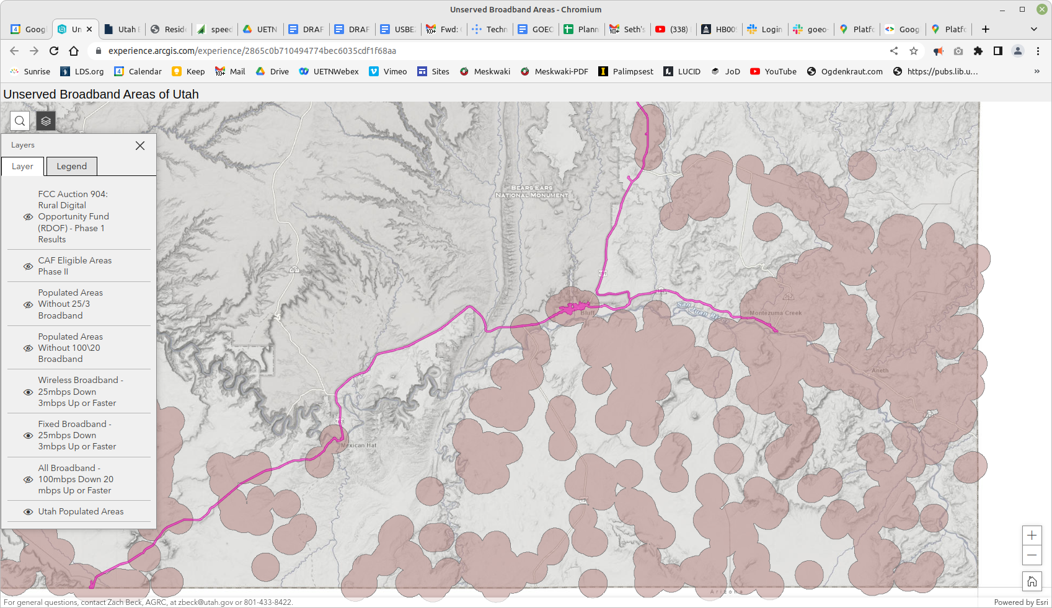

Slide 71
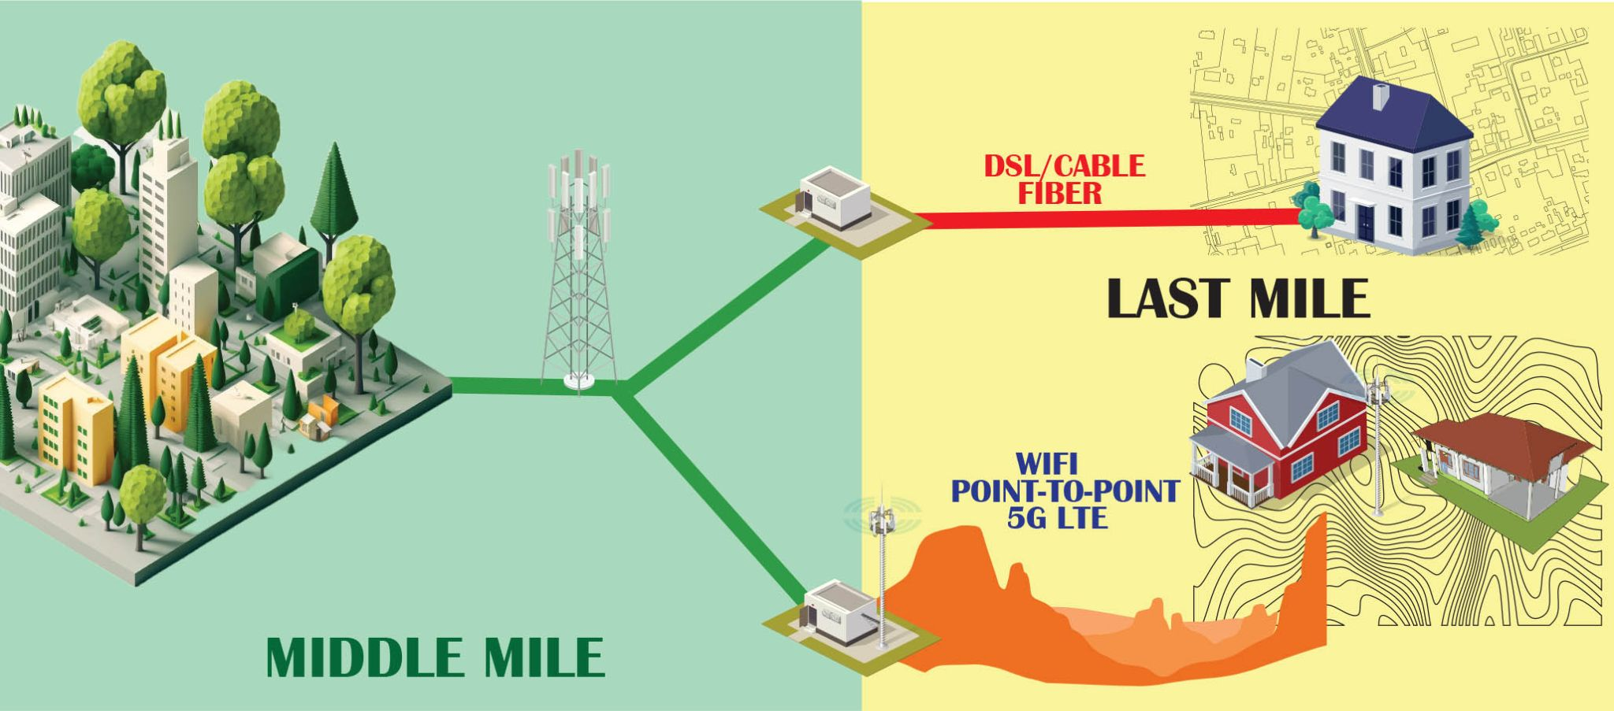

Slide 72
“SchoolNET”
…not “internet”

Slide 73
“By Student, by Standard”
“By Address”

Slide 74
Alpine City
Beaver County
Bear River Association of Governments
Box Elder, Cache, and Rich Counties
Davis School District
Five County Association of Governments
Beaver, Garfield, Kane, Iron and Washington
Morgan County
Ogden City
San Juan County
Six County Association of Governments
Juab, Millard, Piute, Sanpete, Sevier, Wayne
Southeastern Utah Association of Local Governments
Summit County
Town of Brighton
Utah Department of Transportation
Utah Education Network
Wallsburg Town

